Slide 1
MT104-Linear Algebra

Slide 2

What is Linear Algebra ?
Definition: Linear algebra is the branch of mathematics concerning vector space and linear mapping
between such spaces.
OR
Linear algebra is the study of linear systems of equations.

Slide 3
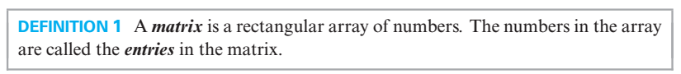

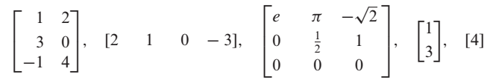
A

Slide 4
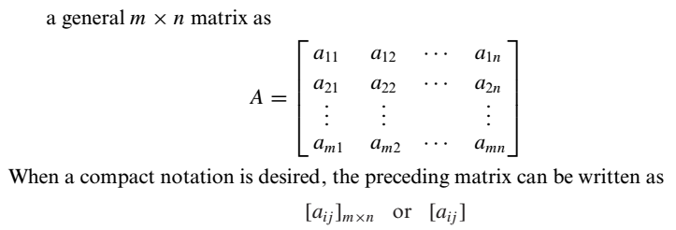
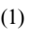
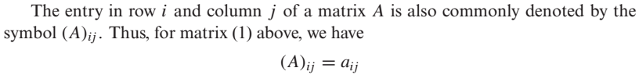
A
is

Slide 5
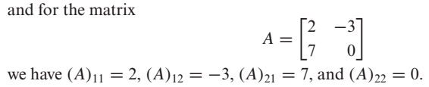

Slide 6
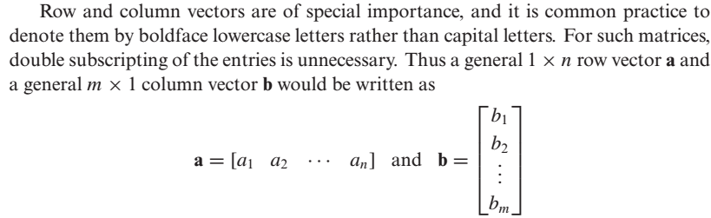
Row Vector and Column Vector

Slide 7
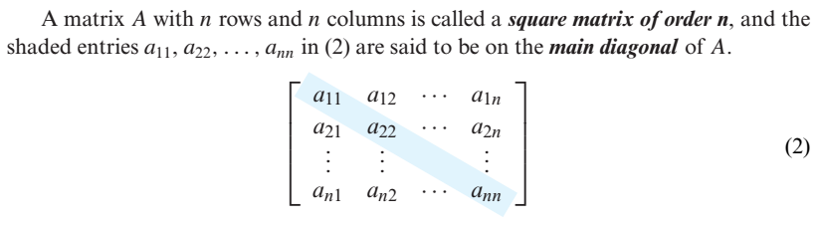
Square Matrix and Main Diagonal

Slide 8

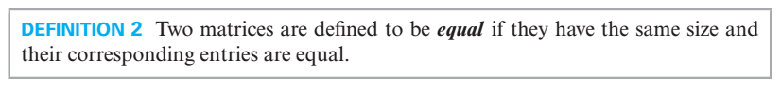
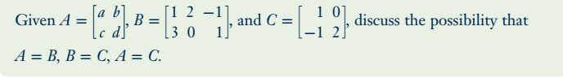
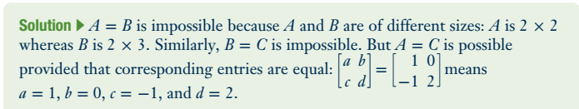
Problem

Slide 9
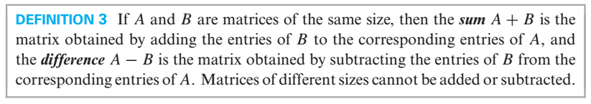
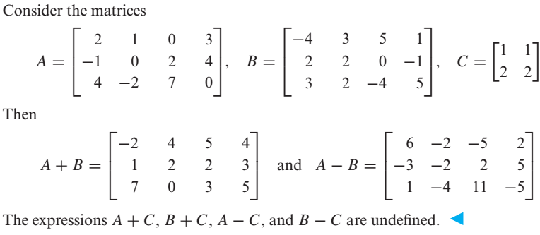

Slide 10
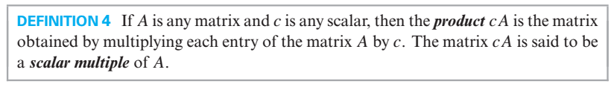
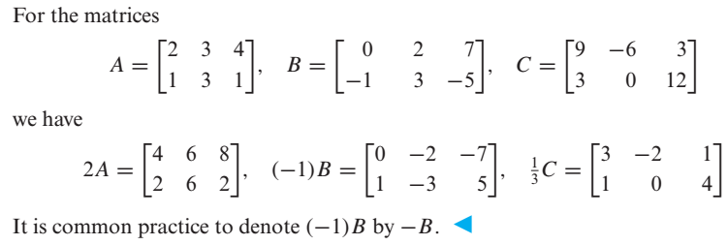
Scalar Multiples of a Matrix

Slide 11
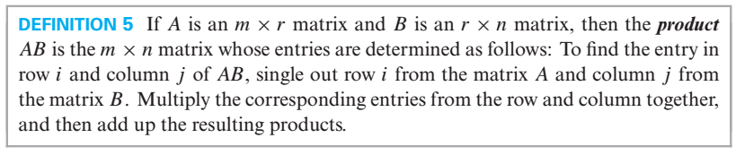
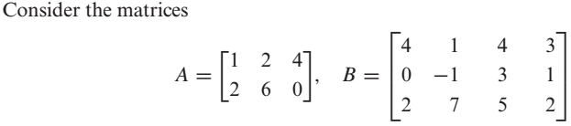
Product of Two Matrices

Slide 12
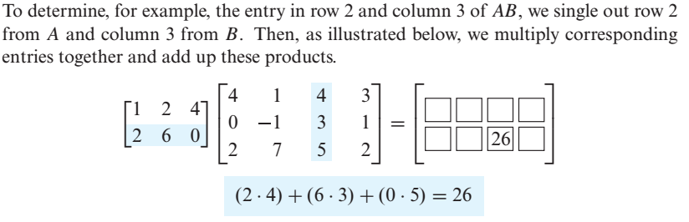
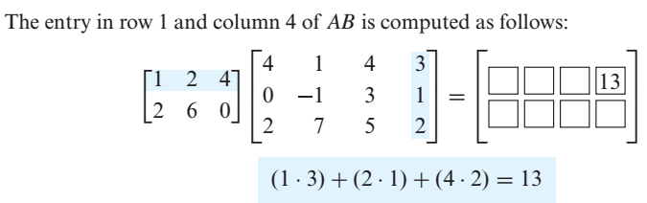

Slide 13
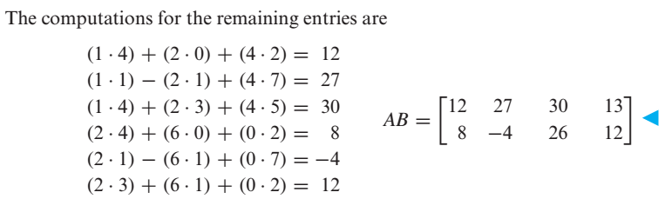

Slide 14
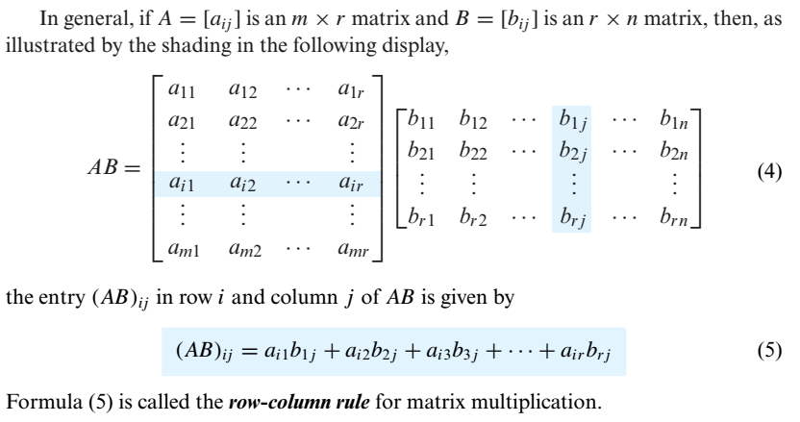

Slide 15

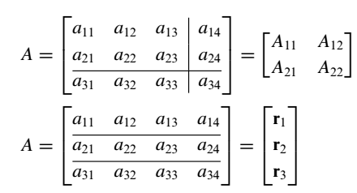
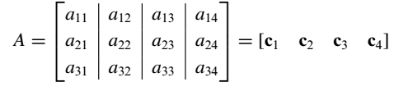
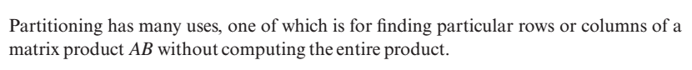
e.g

Slide 16

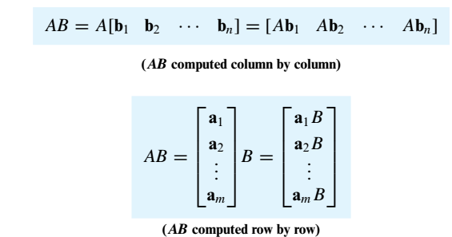

Slide 17
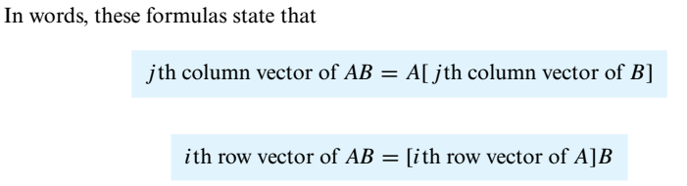
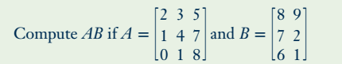
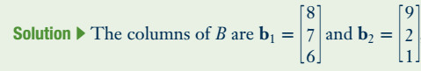
Problem

Slide 18
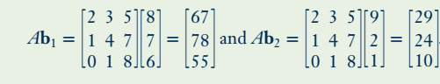
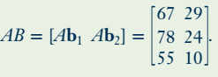

Slide 19
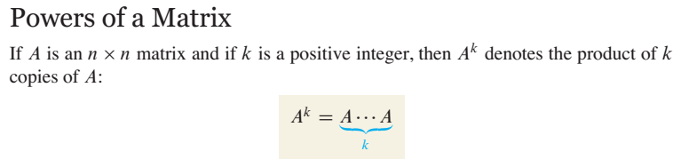
For instance , in order to find $A^{2}$ we will multiply $A$ with $A$.

Slide 20
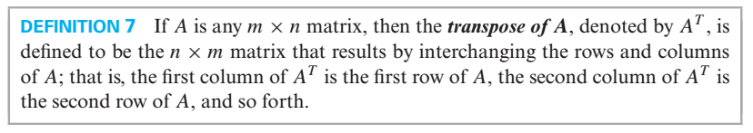
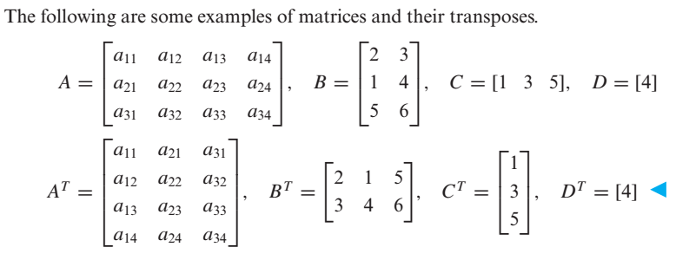
Transpose of a Matrix

Slide 21
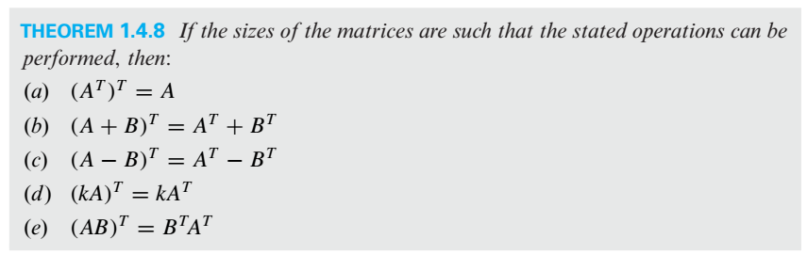
Properties of Transpose

Slide 22
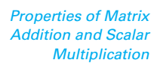
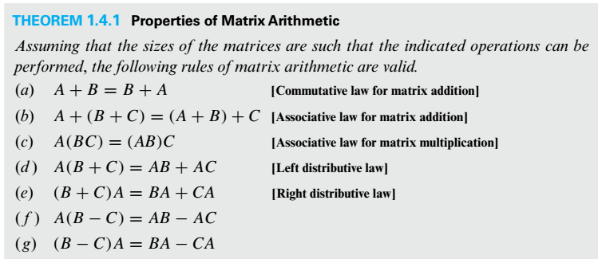

Slide 23
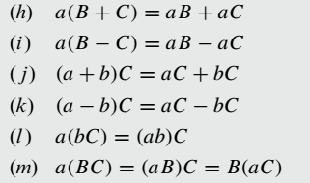

Slide 24
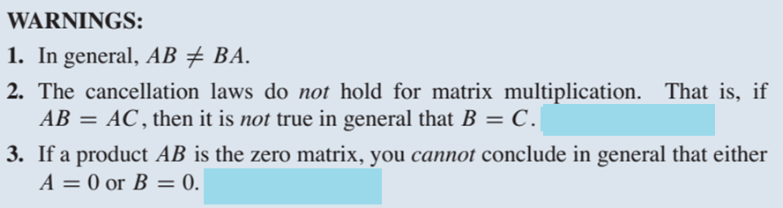
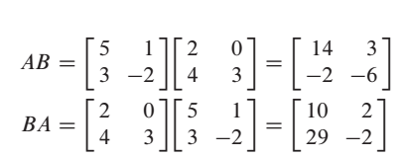
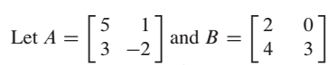
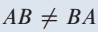
Example on Point 1

Slide 25
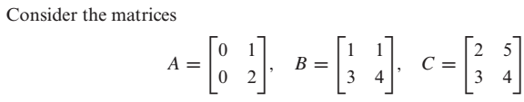
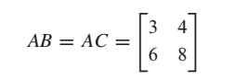
Example on Point 2
Here
But

Slide 26
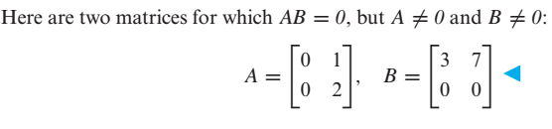
Example on Point 3

Slide 27

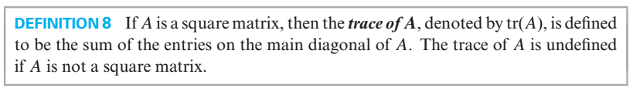
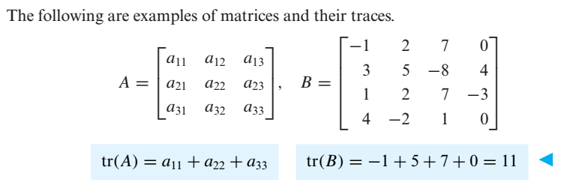

Slide 28
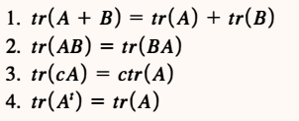

Slide 29

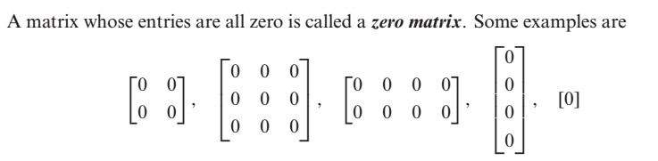

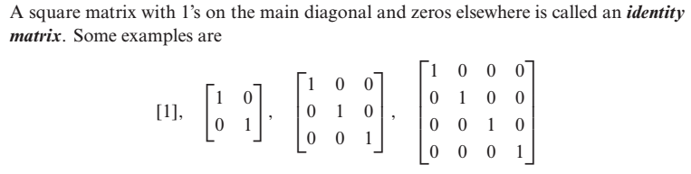

Slide 30

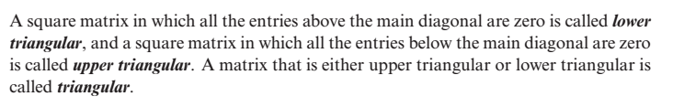


Slide 31




Slide 32


Slide 33





Equivalent Matrices
e.g $I_{2}$and the matrix
are equivalent because we can obtain A from identity matrix by multiplying row 2 by -3
Elementary Matrix

Slide 34


Slide 35


Determinants
For 2×2 Matrices the formula is
Let’s talk about minor and cofactor of an element with the help of which we will calculate determinants of higher order matrices.

Slide 36




Minor & Cofactor of an element (In a Square Matrix)

Slide 37


Slide 38



Slide 39



Problem
By cofactor expansion along the first Row

Slide 40


By cofactor expansion along the first coulmn

Slide 41



Slide 42

e. g

Slide 43



Slide 44



Slide 45



Slide 46




Slide 47




Slide 48



Slide 49



Slide 50




Slide 51



Slide 52



In general

Slide 53

Evaluating Determinants by Row Reduction

Slide 54




Slide 55




Slide 56



Slide 57



Slide 58





Slide 59



Slide 60


Slide 61





Inverse of a 2 $×$ 2 Matrix

Slide 62


Slide 63





Problem
Find the inverse of the matrix
Sol
Another method for finding inverse of a matrix is illustrated in the coming slides.

Slide 64



Slide 65


Slide 66



Slide 67


Slide 68


Note

Slide 69



Slide 70





Slide 71


Slide 72





Slide 73

General Form of a Diagonal Matrix

Slide 74


Inverse of a Diagonal Matrix
Power of a Diagonal Matrix

Slide 75


Slide 76


A matrix is said to be in Echelon form if it has the following properties
Every nonzero row precedes every zero row.
In each successive nonzero row, the number of zeros before the leading entry of a row
increases row by row.

Slide 77





Slide 78


Rank of a Matrix
The number of nonzero rows in the echelon form of a matrix is called rank of the matrix.

Slide 79






Linear System
is a solution of

Slide 80


In matrix form, we can write ( ) as
where,
A is called the

Slide 81


Slide 82




Slide 83


Slide 84

Important Points about Linear Systems
There are a lot of methods for solving linear systems, some methods work in special cases while some works for every type of linear system.
If in a linear system the number of equations is equal to the number of unknowns ( i.e. if the coefficient matrix is a square matrix i.e. if m = n ) then from determinant we can comment about the number of solution(s).
Any linear system in which $m=n$, and $\left|A\right|≠0$, has a unique solution. We can obtain this
unique solution by any of the following methods:
(i) Matrix Inversion Method (ii) Cramer's Rule
(iii) Gauss Elimination (iv) Gauss-Jordan Elimination
Furthermore, if the system is homogeneous then this unique solution is the trivial solution
(zero solution).

Slide 85

A homogeneous system has always a zero solution called trivial solution. Thus a homogeneous system is always consistent.
A homogeneous linear system in which $m=n$, and $\left|A\right|=0$, has infinite solutions ( i.e.
nontrivial solutions also exist).
5. In case of nonhomogeneous linear system in which $m=n$ and $\left|A\right|=0$, there is possibility
that the system has
(i) No Solution (ii) Infinite Solutions
6. If in a linear system the number of equations is not equal to the number of unknowns ( i.e. if
the coefficient matrix is not a square matrix i.e. if m $≠$n ) then we can comment about the
number of solution(s) by looking into the rank of coefficient matrix, rank of augmented
matrix and number of unknowns in the system. In this case we can find the solution(s) (if
exist) by either Gauss Elimination or by Gauss-Jordan Elimination.
(i)

Slide 86


Slide 87

(Because for homogeneous linear system Rank of the coefficient matrix is always equal to Rank of the augmented Matrix and if number of equations is less than unknowns this mean that common rank < n, so by third part of fundamental theorem, system will have infinite solutions.

Slide 88


Methods for solving a linear System
(or Gauss Elimination)

Slide 89


Problem

Slide 90





Slide 91





Slide 92





Slide 93



Slide 94




Slide 95




Slide 96



Slide 97


Slide 98


Slide 99


Problem

Slide 100


If we reduced the augmented matrix to reduce echelon form we have

Slide 101


Slide 102


Slide 103


Problem

Slide 104



e.g.

Slide 105





Slide 107



Slide 108


Some important definitions from chapter 3

Slide 109


Slide 110




Slide 111


Slide 112


Slide 113


Slide 114



Slide 115


Slide 116



Slide 117






Slide 118




Slide 119



Slide 120


Slide 121




Slide 122


Linear Combination

Slide 123



Slide 124


Slide 125

Spanning Set

Slide 126



Slide 127


Two Major Problems to Address
Problem

Slide 128




Slide 129


Problem

Slide 130


Slide 131




Slide 132


Slide 133


Problem

Slide 134



Slide 135



Slide 136



Slide 137

Wronskian

Slide 138



Slide 139




Slide 140



Slide 141


Slide 142


Dimension

Slide 143




Slide 144



Slide 145


Slide 146



Slide 147



Slide 148



Slide 149


Problem

Slide 150


Slide 151


Problem

Slide 152



Slide 153





Slide 154


Problem
Solution

Slide 155


Slide 156


Slide 157



Problem

Slide 158



Slide 159



Problem

Slide 160




Slide 161




Slide 162



Slide 163


Problem

Slide 164


Slide 165


Slide 166


Slide 167


Slide 168


Slide 170



Slide 171




Slide 172



We know even simple vector space like $R^{2} and R^{3}$ have a richer structure. The concept of angle, length and distance turn $R^{2} and R^{3}$ into Euclidean space. We define the notions for any vector space.

Slide 173


OR Let V be a vector space over R, an inner product on V is an operation defined on pairs of vector, which gives a scalar. It is denoted by $<u,v>$and satisfies the following axioms

Slide 174





Slide 175


Slide 176


$$Let r=c_{0}+c_{1}+…+c_{n}$$
$$\left(i\right) <p,q> =a_{0}b_{0}+…+a_{n}b_{n}$$
$$=b_{0}a_{0}+…+b_{n}a_{n}$$
$=<q,p>$
$$\left(ii\right) <p+r,q> ={(a}_{0}+c_{0})b_{0}+{(a}_{1}+c_{1})b_{1}+…+{(a}_{n}+c_{n})b_{n}$$

Slide 177

$$<p+r,q> ={(a}_{0}+c_{0})b_{0}+{(a}_{1}+c_{1})b_{1}+…+{(a}_{n}+c_{n})b_{n}$$
$$=a_{0}b_{0}+c_{0}b_{0}+a_{1}b_{1}+c_{1}b_{1} +…+a_{n}b_{n}+c_{n}b_{n}$$
$={(a}_{0}b_{0}+a_{1}b_{1} +…+a_{n}b_{n})+{(c}_{0}b_{0}+c_{1}b_{1}+…+c_{n}b_{n}$)
$$=<p,q>+<r,q>$$
$$\left(iii\right) k<p,q> ={k(a}_{0}b_{0}+a_{1}b_{1}…+a_{n}b_{n})$$
$$={(ka}_{0}{)b}_{0}+(ka_{1})b_{1}…+{(ka}_{n})b_{n}$$
$$=<kp,q>$$

Slide 178
$$\left(iv\right) <p,p> ={(a}_{0}a_{0}+a_{1}a_{1}…+a_{n}a_{n})$$
$$=a_{0}^{2}+a_{1}^{2}+…+a_{n}^{2})≥0$$
$$The above expression is zero iff P=0 and this is possible only when{ a}_{0}=a_{1}…=a_{n}=0$$

Slide 179


Slide 180


Slide 181


Practice Problems

Slide 182



Slide 183




Slide 185




Slide 186




Slide 187

Norm of a vector and Distance b/w two vectors in an Inner Product Space
Remarks:
(i) $<v,v> ≥0$ ( by property 4)

Slide 188
(ii) $\left\|v\right\|$ coinsides with the usual Euclidean length in $R^{2} or R^{3}.$
(iii) $\left\|v\right\|$ indeed a norm, in i.e it satisfies the 3-Axioms
(c) $\left\|u+v\right\|≤\left\|u\right\|+\left\|v\right\|$ (Triangular inequality )
(iv)
(v)

Slide 189




Slide 190



Slide 191





Slide 192





Slide 193




Slide 194




Slide 195






Slide 196




Slide 197




Slide 198



Slide 199



Slide 200



Slide 201




Slide 202




Slide 203



Slide 204


Slide 205





Slide 206



Slide 207




Slide 208

Technique for making an orthogonal set an orthonormal Set

Slide 209



Slide 210

Problem

Slide 211


Simply speaking, orthogonality implies linear independency

Slide 212


Slide 213




Problem

Slide 214






Slide 215


Slide 216


Practice Problem

Slide 217



Slide 218



Slide 219



Slide 220


Problem
Also find least squares error vector and least square error.
Sol:

Slide 221




Slide 222


Slide 223


Problem

Slide 224



Slide 225


Slide 226

Note

Slide 227

Practice Problem

Slide 228



Slide 229


Slide 230


Slide 231


Slide 232


Slide 233


Slide 234


Slide 235


Slide 236

Problem

Slide 237


Slide 238


Slide 239

The question is : How to find the eigenvalues and eigenvectors of a given matrix.

Slide 240


Slide 242


Slide 243


Problem

Slide 244



Slide 245


Slide 246


Problem

Slide 247




Slide 248



Slide 249




Slide 250




Slide 251


Problem

Slide 252


Slide 253



Slide 254


Similarly

Slide 255


Slide 256



Similar Matrices

Slide 257





and
are similar matrices
because there is
such that

Slide 258

Diagonalizable Matrix
e.g
is diagonalizable
A is similar to the diagonal matrix
( Detail in previous Slide)

Slide 259


Slide 260


Slide 261


Problem

Slide 262




Slide 263



Slide 264



Slide 265



Slide 266




Slide 267



Slide 268


Problem

Slide 269




Slide 271


Slide 272




Slide 273


Slide 274





Slide 275



Slide 276




Problem
( Previous Slides )

Slide 277



Slide 278



Slide 279


Slide 280



Slide 281


Slide 282



Problem

Slide 283



Slide 284


Slide 285




Slide 286


Slide 287

Problem

Slide 288



Slide 289


Slide 290


Slide 291

Problem

Slide 292


Slide 293



Slide 294

Problem

Slide 295


Slide 296

Problem

Slide 297


Slide 298


Slide 299


Slide 300


Problem

Slide 301


Slide 302


Problem

Slide 303



Slide 304
Practice Problem

Slide 305


Method for finding standard Matrix for a Linear Transformation from $R^{n}$ to $R^{m}$

Slide 306



Problem

Slide 307




Slide 308

Practice Problem

Slide 309



Slide 310




Problem

Slide 311



(Because determinant of the standard matrix for T is non zero)

Slide 312


Slide 313
The End

